Slide 1

Naive Bayes Classifier
Presented by:
Elizer Ponio Jr.
Department of Computer Science
College of Computing and Information Technologies

Slide 2


Slide 3
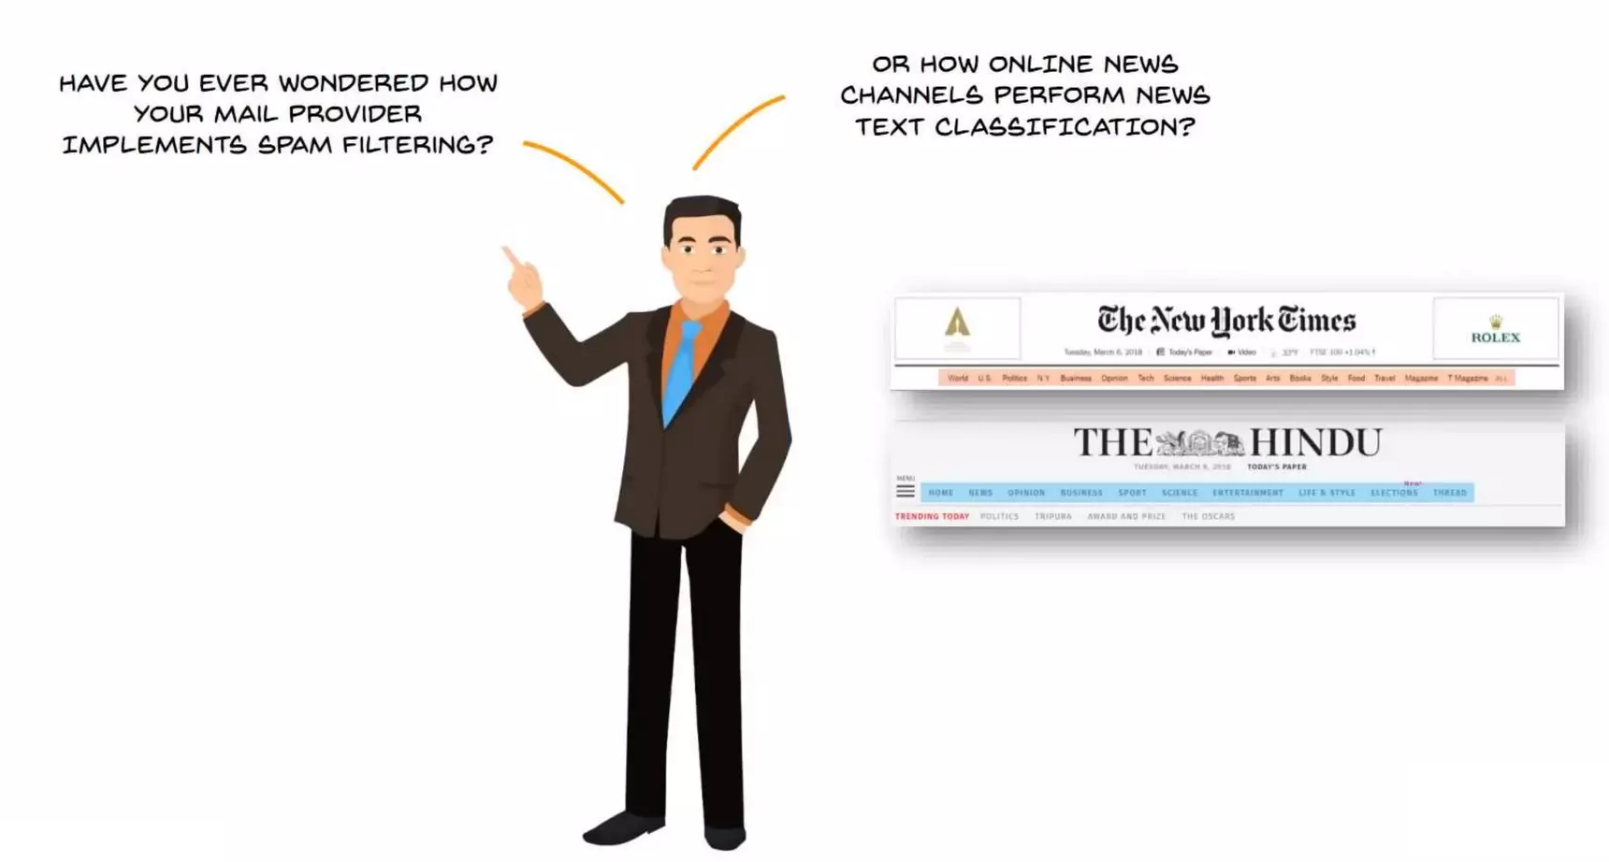

Slide 4
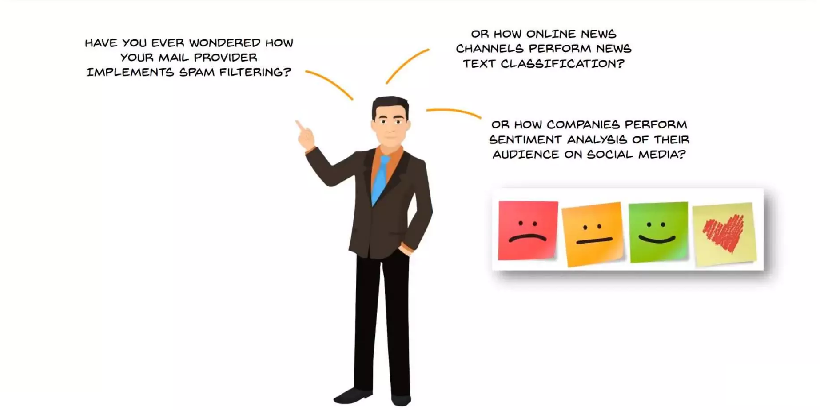

Slide 5
Outline
What is Naive Bayes?
Naive Bayes and Machine Learning
Why do we need Naive Bayes?
Understanding Naive Bayes Classifier
Advantages of using Naive Bayes

Slide 6
Introducing Bayes Theorem
Naive Bayes Classifier works on the principles of conditional probability as given by the Bayes Theorem.

Slide 7
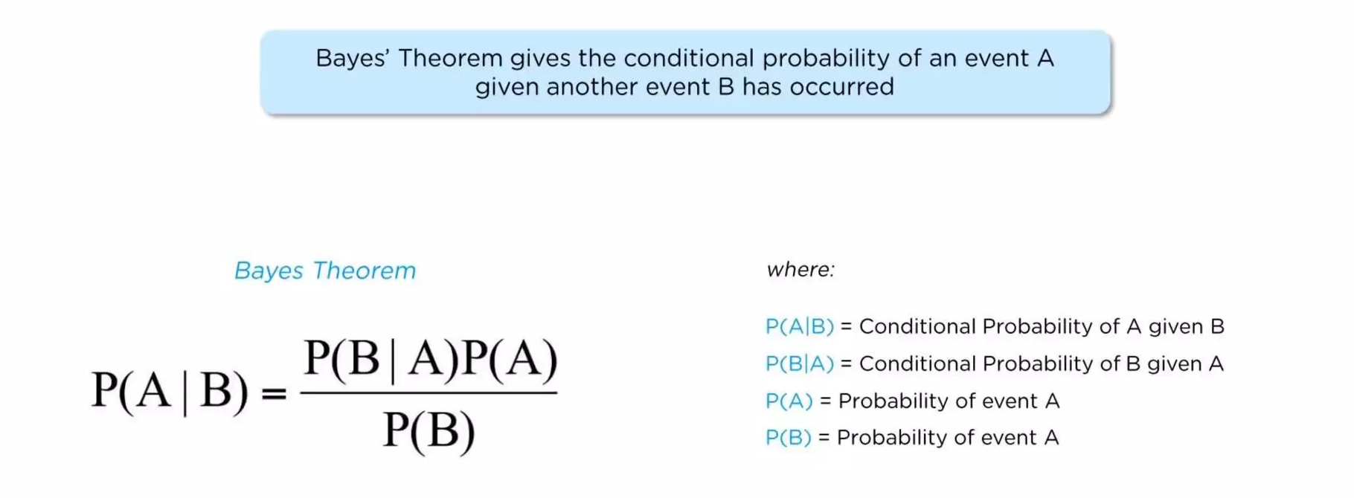

Slide 8
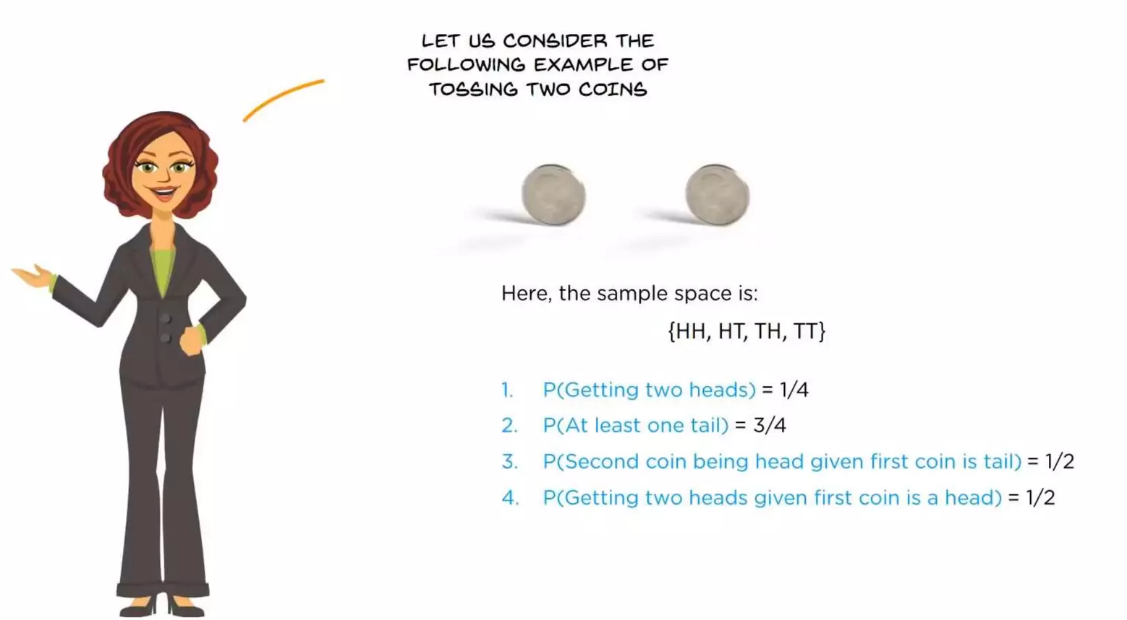

Slide 9
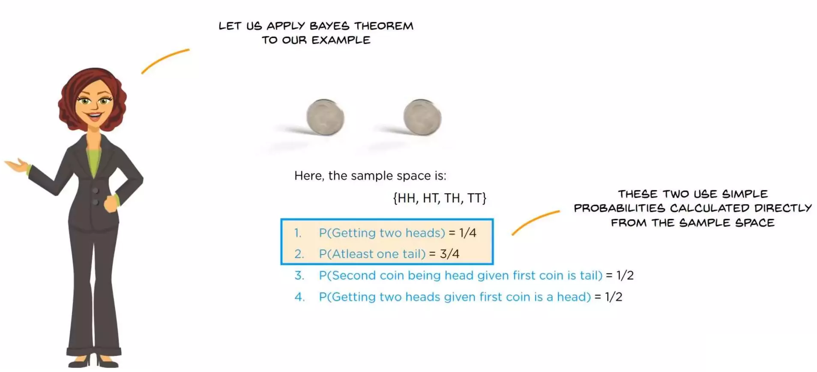

Slide 10
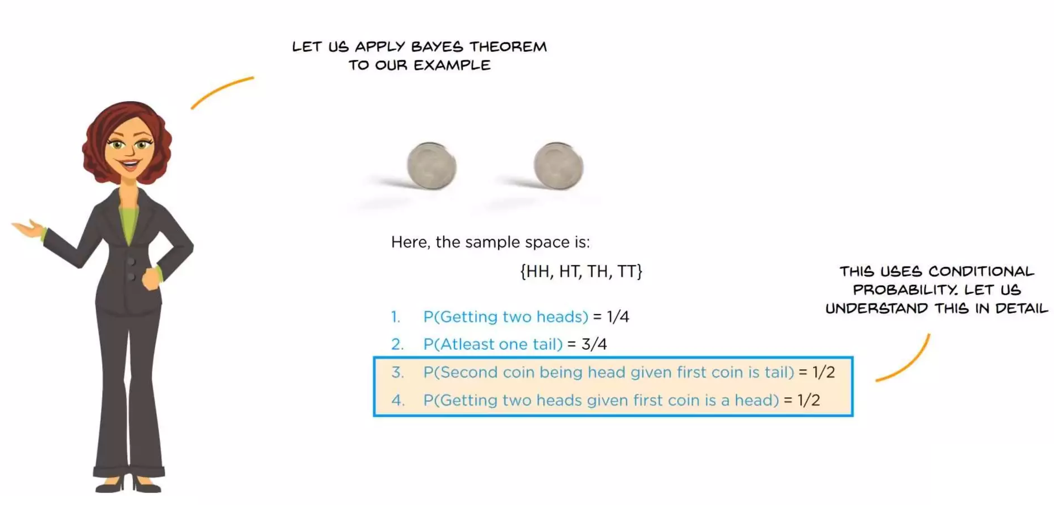

Slide 11
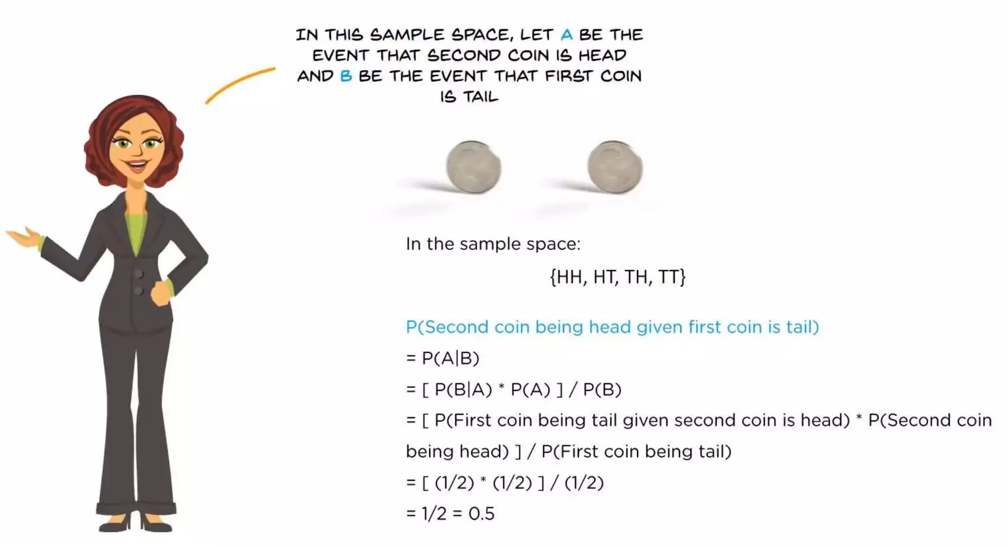

Slide 12
Introducing Bayes Theorem
Bayes Theorem basically calculates the conditional probability of the occurrence of an event based on prior knowledge of conditions that might be related to the event.

Slide 13

What is Naive Bayes?
Naive Bayes and Machine Learning
Why do we need Naive Bayes?
Understanding Naive Bayes Classifier
Advantages of using Naive Bayes

Slide 14
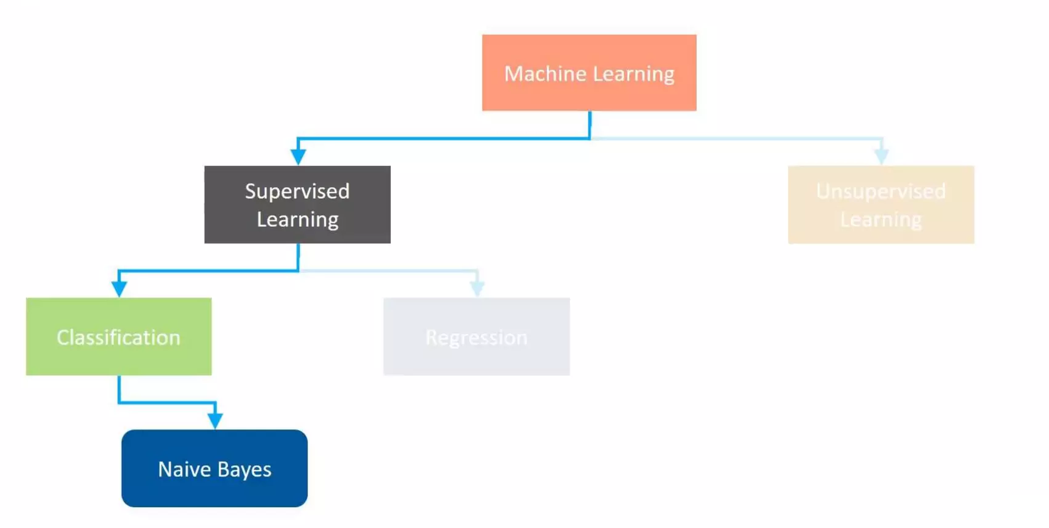

Slide 15
What is Naive Bayes?
Naive Bayes and Machine Learning
Why do we need Naive Bayes?
Understanding Naive Bayes Classifier
Advantages of using Naive Bayes

Slide 16
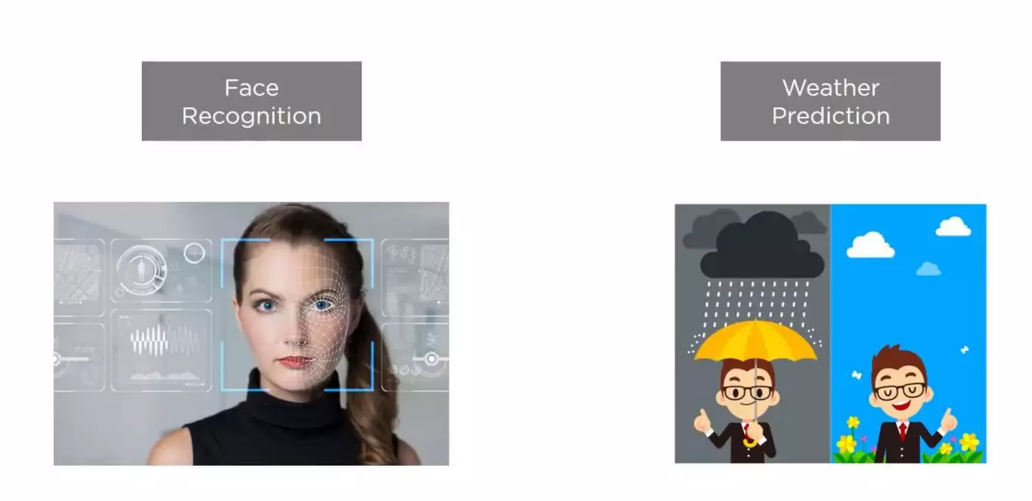

Slide 17
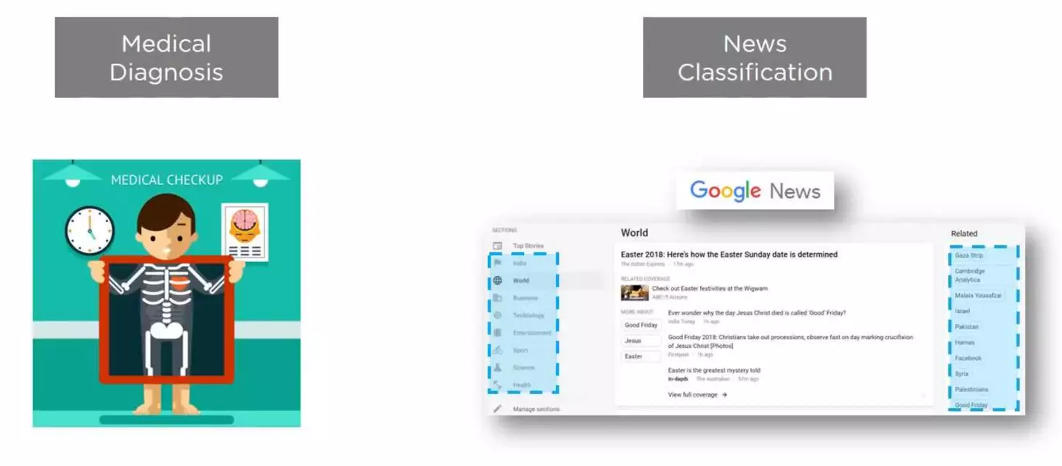

Slide 18
What is Naive Bayes?
Naive Bayes and Machine Learning
Why do we need Naive Bayes?
Understanding Naive Bayes Classifier
Advantages of using Naive Bayes

Slide 19
Understanding Naive Bayes Classifier

Slide 20
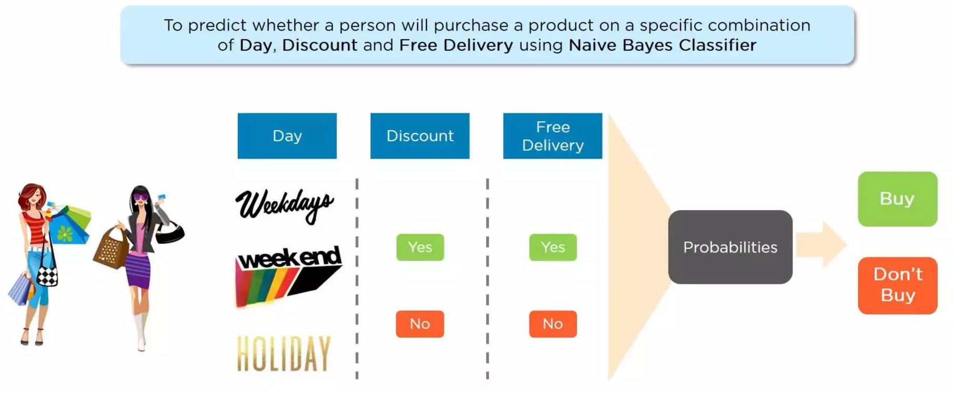
Shopping Prediction Example

Slide 21
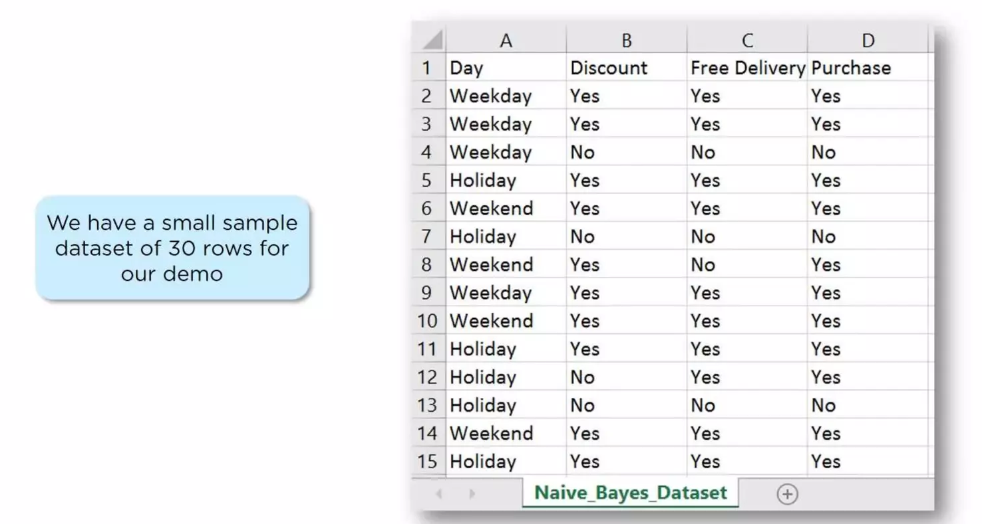
Shopping Prediction - Dataset

Slide 22
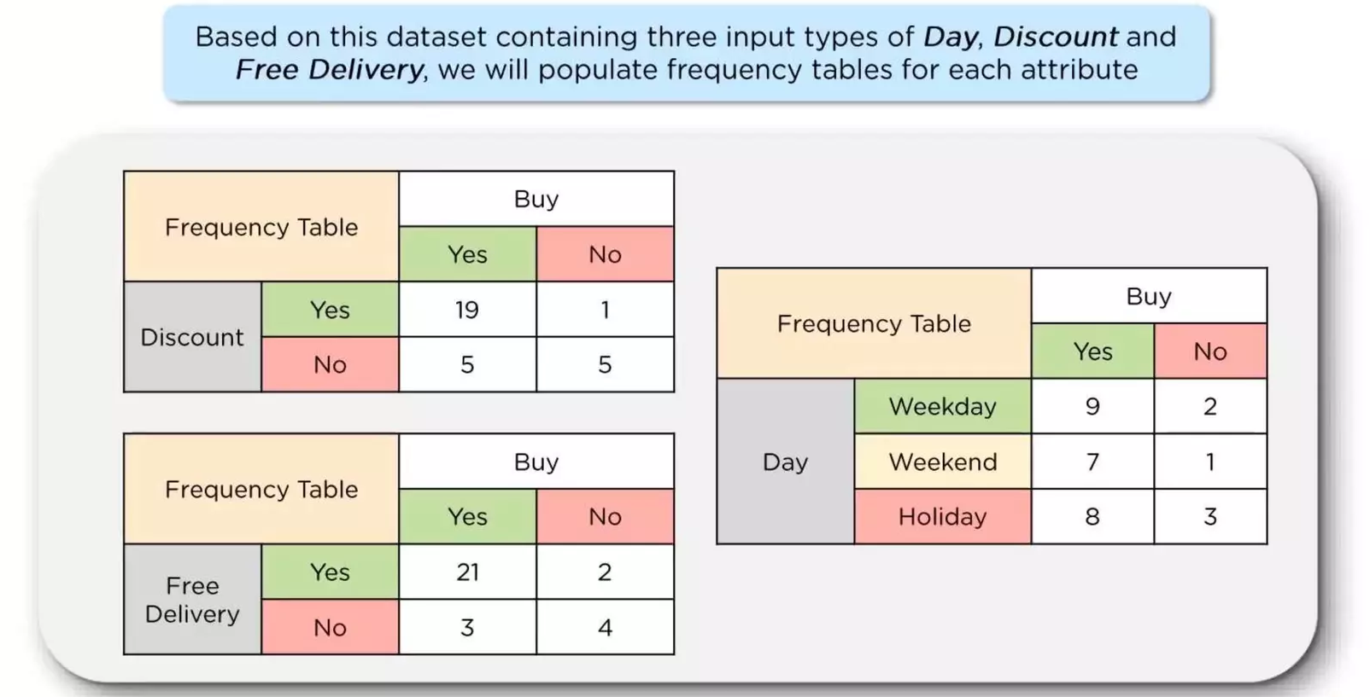
Shopping Prediction - Frequency Table

Slide 23
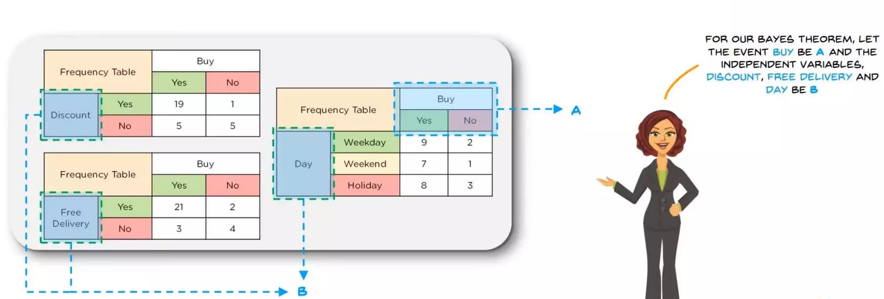
Shopping Prediction - Frequency Table

Slide 24
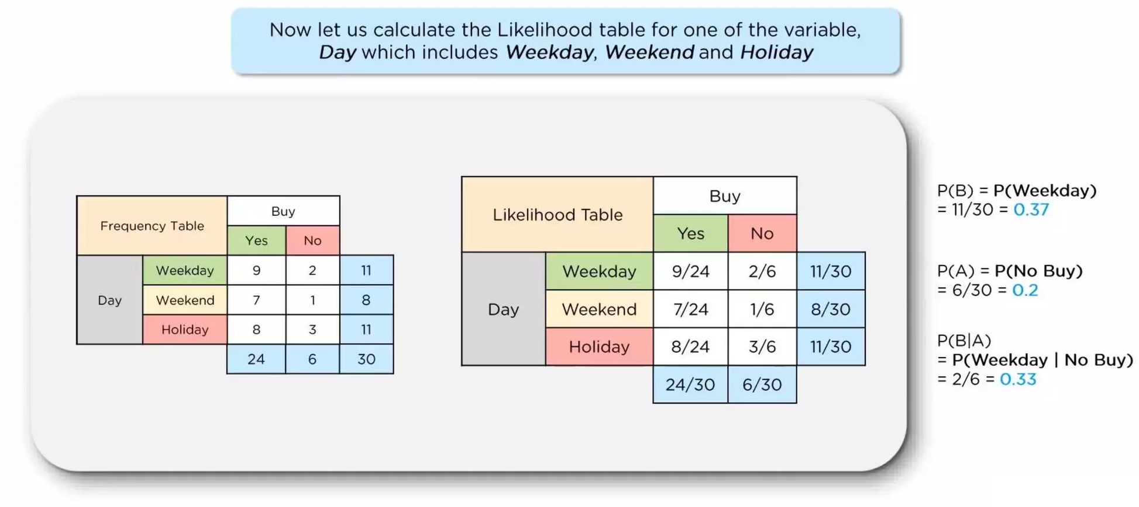
Shopping Prediction - Likelihood Table

Slide 25
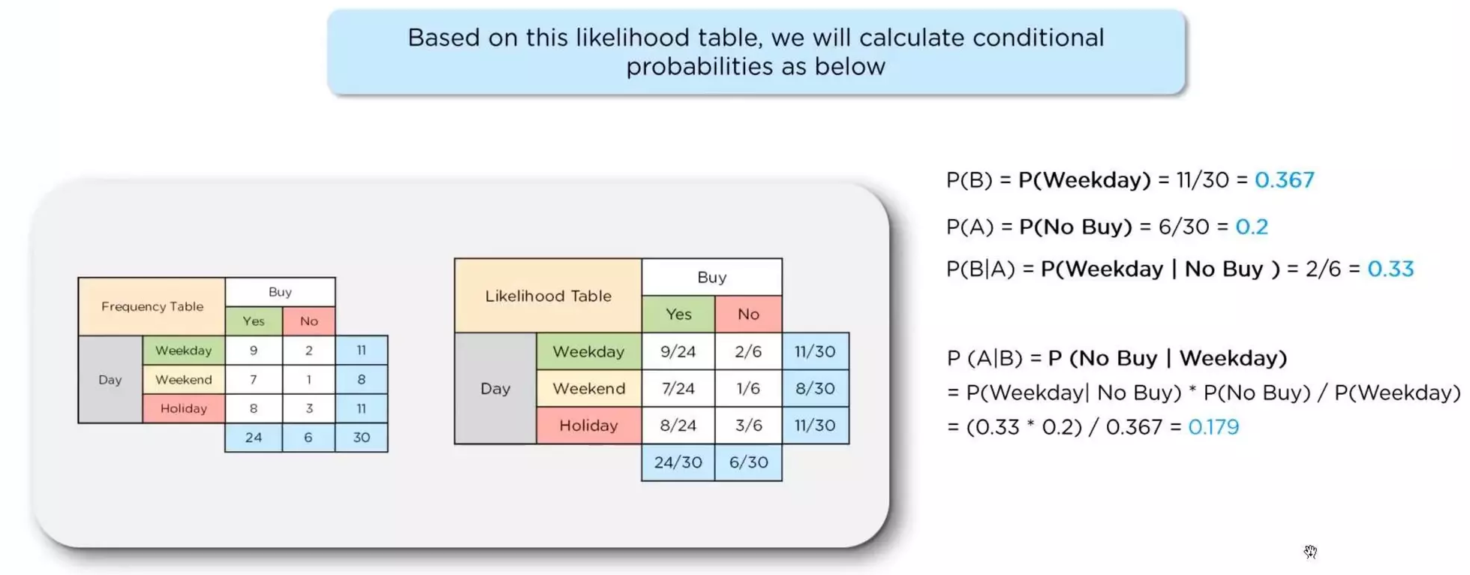
Shopping Prediction - Likelihood Table

Slide 26
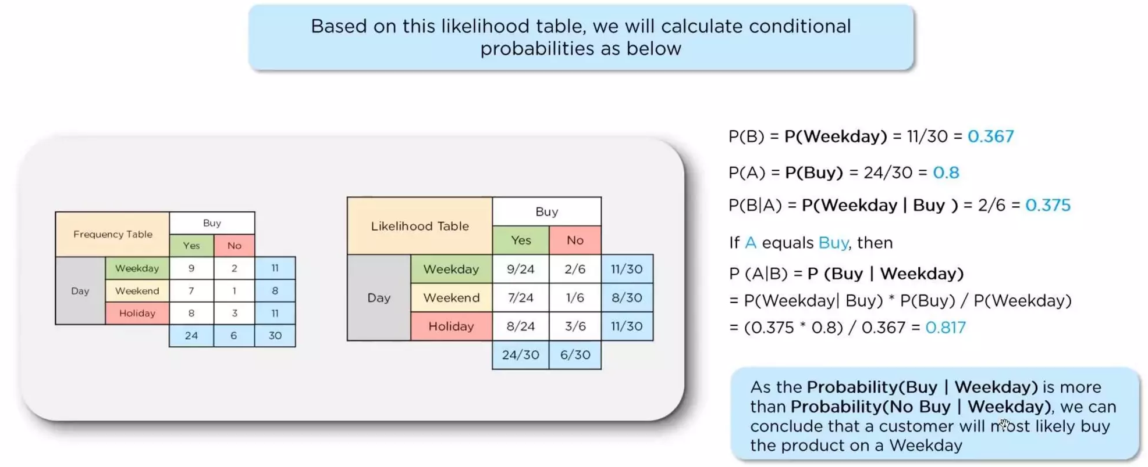
Shopping Prediction - Likelihood Table

Slide 27
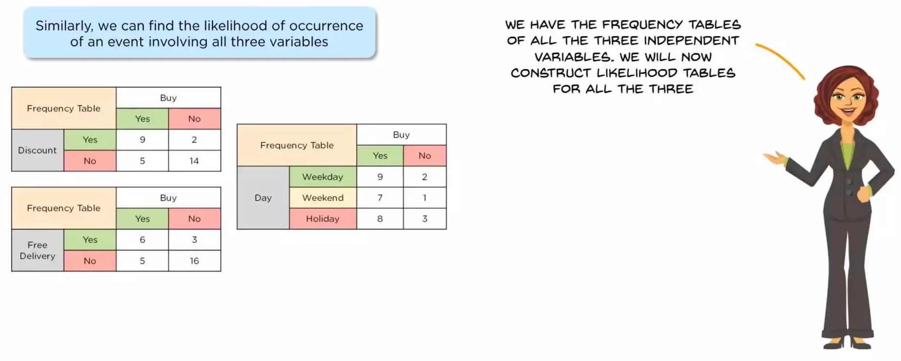
Shopping Prediction - Naive Bayes Classifier

Slide 28
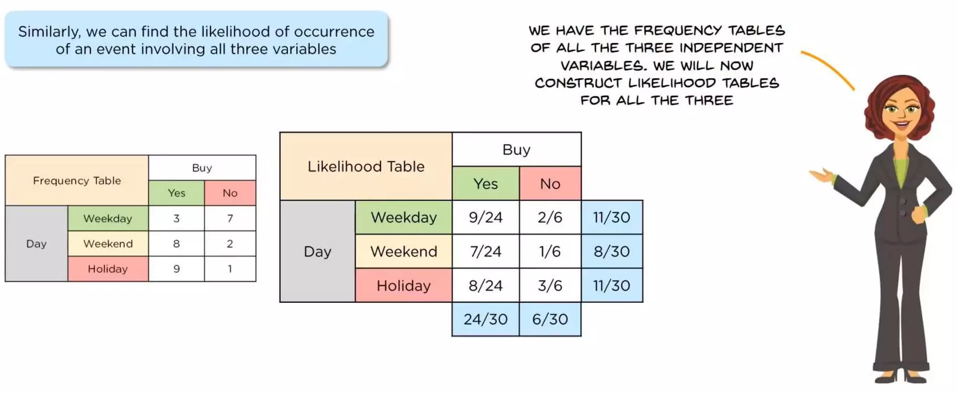
Shopping Prediction - Naive Bayes Classifier

Slide 29
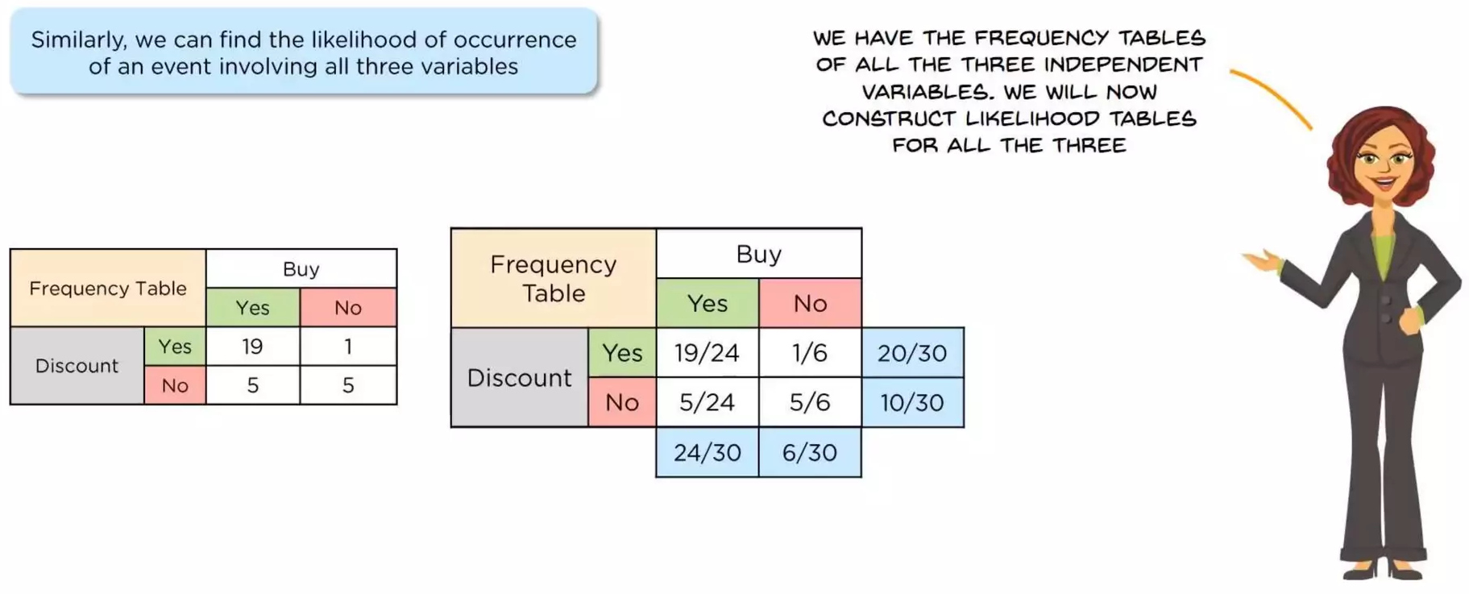
Shopping Prediction - Naive Bayes Classifier

Slide 30
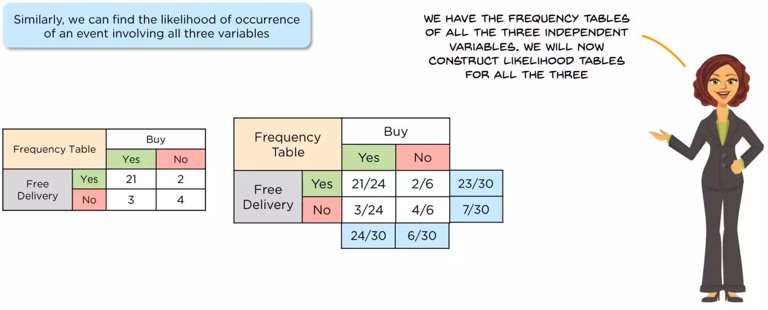
Shopping Prediction - Naive Bayes Classifier

Slide 31
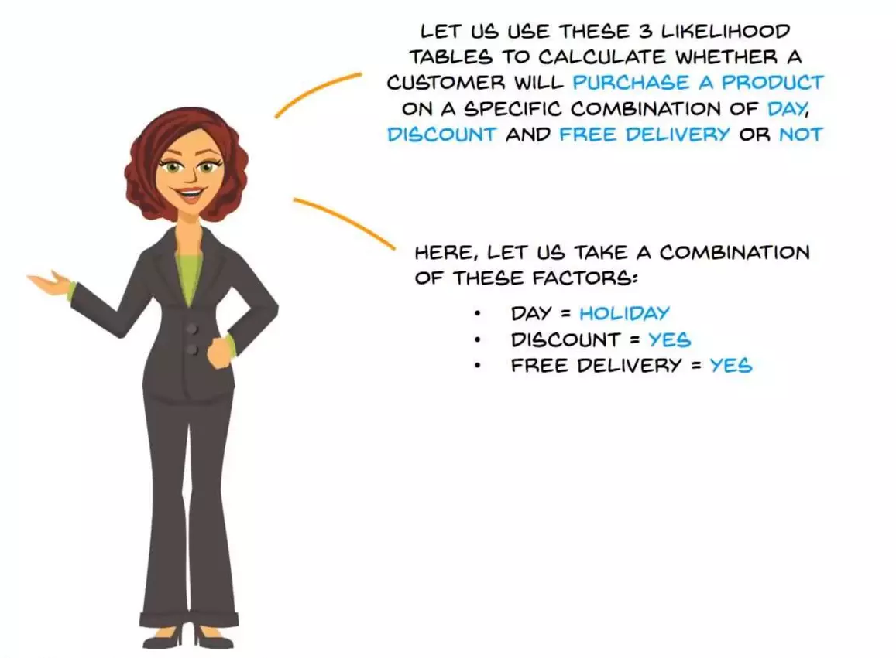

Slide 32
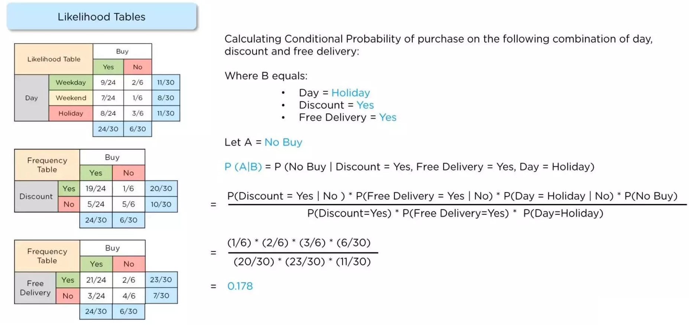
Shopping Prediction – No Buy

Slide 34
Shopping Prediction – No Buy

Slide 35
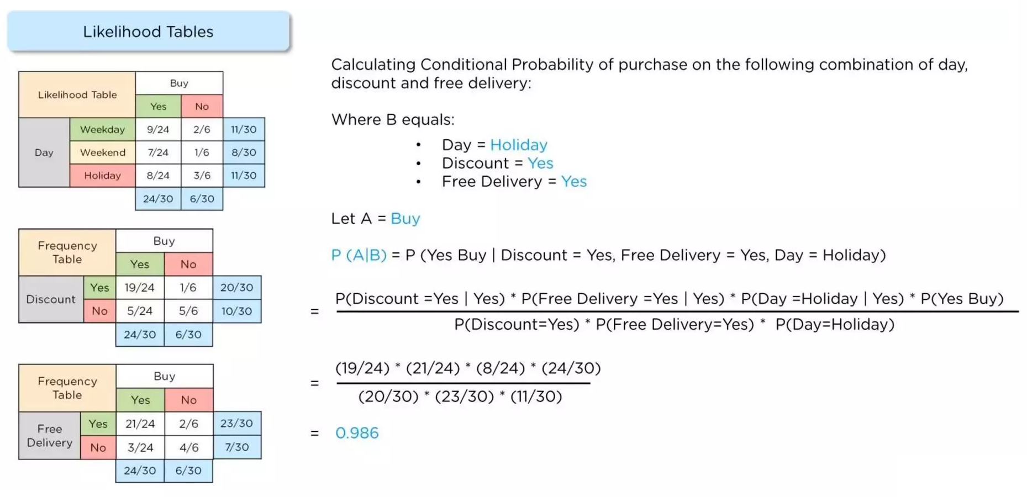
Shopping Prediction – Buy

Slide 36
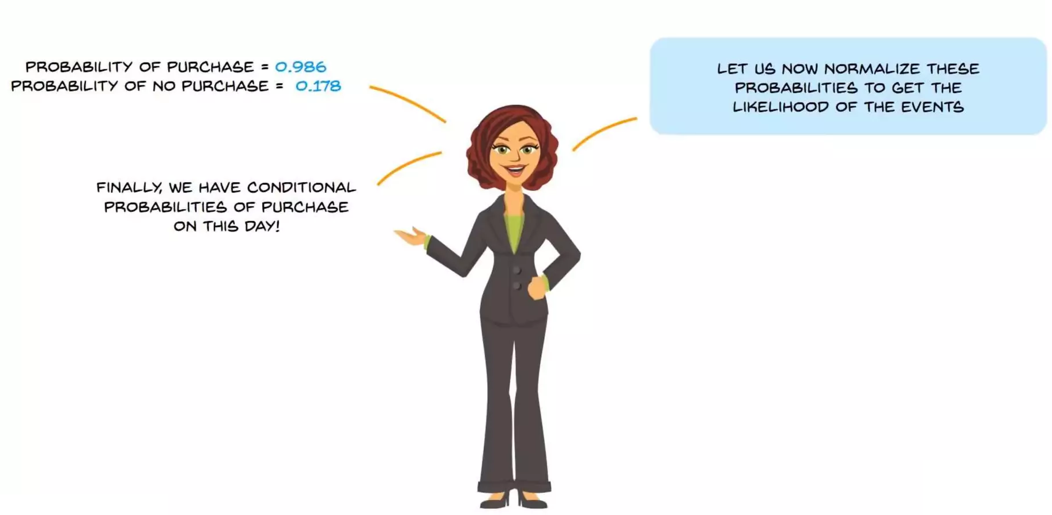
Shopping Prediction - Naive Bayes Classifier

Slide 37
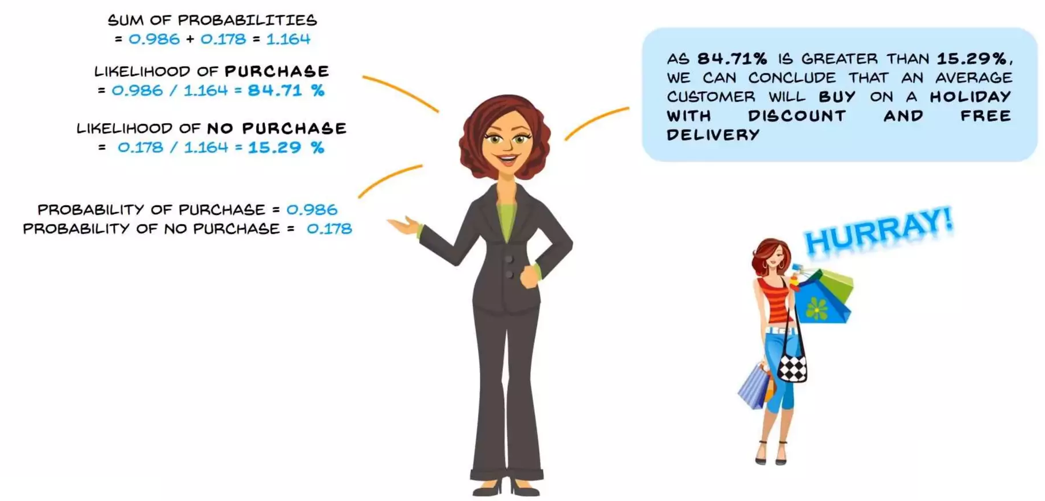
Shopping Prediction - Result

Slide 38
What is Naive Bayes?
Naive Bayes and Machine Learning
Why do we need Naive Bayes?
Understanding Naive Bayes Classifier
Advantages of using Naive Bayes

Slide 39
